Slide 1
“learnX.ai”
GROUP MEMBERS
Amir Bhattarai
DATE: OCT. 04, 2024

Slide 2
OBJECTIVE
To customize the learning method by generating the questions in various formats.

Slide 3
STATEMENT OF PROBLEM
Traditional method of learning is costly in terms of time. It is also not very engaging for non-learners.

Slide 4
LITERATURE REVIEW
Exploring the Limits of Transfer Learning with a Unified Text-to-Text Transformer.
Introducing a unified framework that converts all text-based language problems into a text-to-text format.
Various evaluation metrics are used for different tasks: SQuAD-Exact match, CNN/Daily, Mail-ROUGE, WMT English to French and German-BLEU, GLUE and SuperGLUE-average scores for all subtasks.
Scores for encoder-decoder with denoising objective: SQuAD(80.88), CNN/Daily Mail(19.24), WMT English to French(39.82), GLUE(83.28).

Slide 5
BERT: Pre-training of Deep Bidirectional Transformers for Language Understanding
BERT pre-trains deep bidirectional representations from text by considering both left and right context. It can be fine-tuned for various tasks without major modifications.
GLUE (Wang et al., 2019) Benchmark consists of a number of tasks such as MNLI, QQP, QNLI, SST-2, CoLA, STS-B, MRPC and RTE. F1 scores are used for QQP and MRPC, Spearman correlations are reported for STS-B, and accuracy scores for the rest of the tasks. Average score across all these tasks are reported. Average Scores: Pre-OpenAI SOTA (74.0), BiLSTM+ELMo+Attn (71.0), OpenAIGPT (75.1), BERT-base (79.6) and BERT-large (82.1). Both
BERT-base and BERT-large outperforms GPT and ELMo on all tasks by substantial margin.

Slide 6
Language Models are Unsupervised Multitask Learners
Fine tuning on downstream tasks i.e. the prevalence of single task training on single domain datasets is a major contributor to the lack of generalization observed in current systems.
Perplexity and Accuracy are mostly used to report the zero-shot results. GPT2, BERT, and original GPT were tested on datasets like LAMBADA, CBT-CN, WikiText2, enwik8.
Accuracy Scores of BERT: LAMBADA (45.99), CBT-CN (87.65), CBT-NE (83.4). Accuracy Scores of GPT-2: LAMBADA (63.24), CBT-CN (93.30), CBT-NE (89.05).

Slide 7
ABOUT DATASETS
Dataset: squad
Training set size: 85599 rows
Validation set: 10570 rows (9513)
Test set: 1057 rows(10% of Validation set)

Slide 8
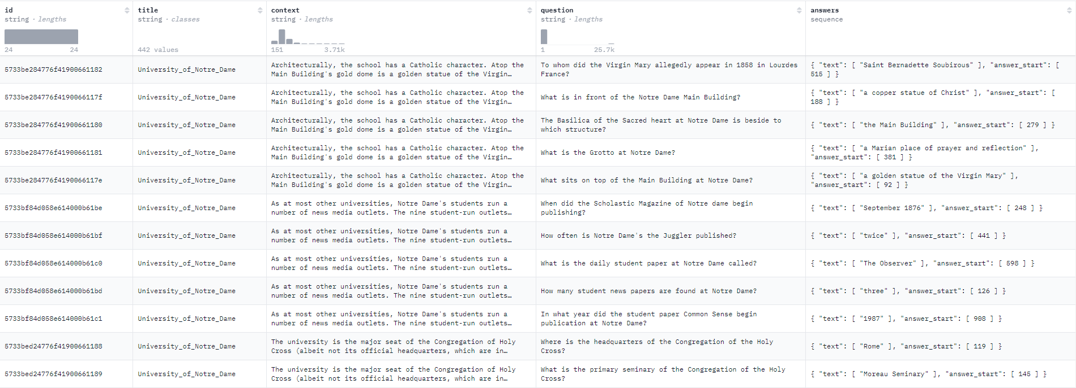
Original Dataset (squad)

Slide 9
Data Preprocessing Steps
Q/A Generation
We prepend a task specific prefix to our inputs and labels, i.e. “context:” and “question” and/or “answer” respectively, followed by the tokenization of inputs and labels using a “t5-base” or “t5-small” tokenizer. The final output consists of triples input_ids, attention_mask and labels.
Token Classification
We first split the squad dataset into words and append them with IOB tags. The IOB tags are then converted to labels 0,1,2. The input in our case are the tokens corresponding to the words. The final output consists of triples input_ids, attention_mask and labels.

Slide 10
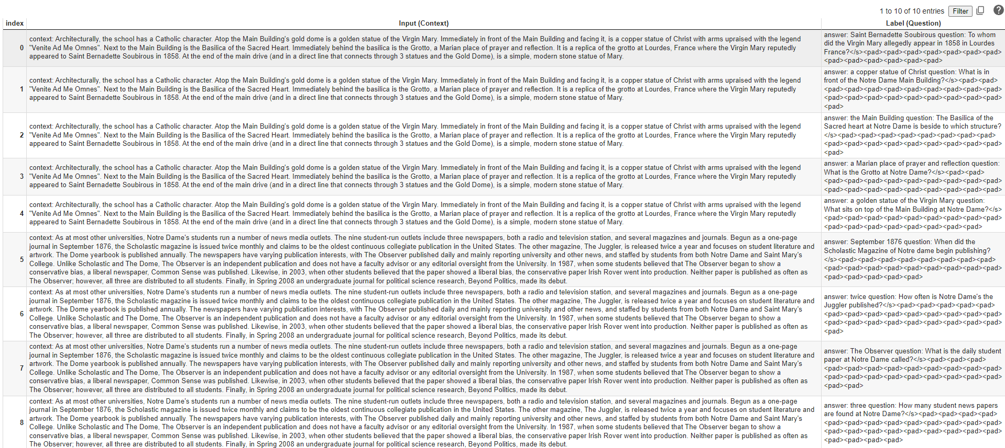
Intermediate Output (Q/A Generation)

Slide 11
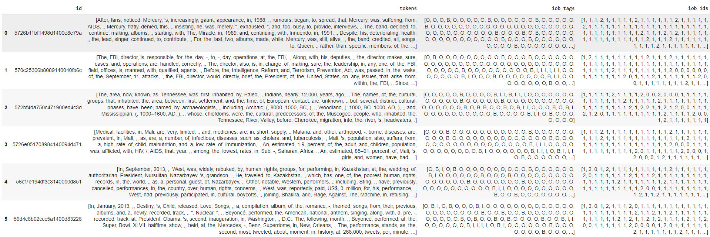
Intermediate Output (Token Classification)

Slide 12
SYSTEM BLOCK DIAGRAM

Slide 13
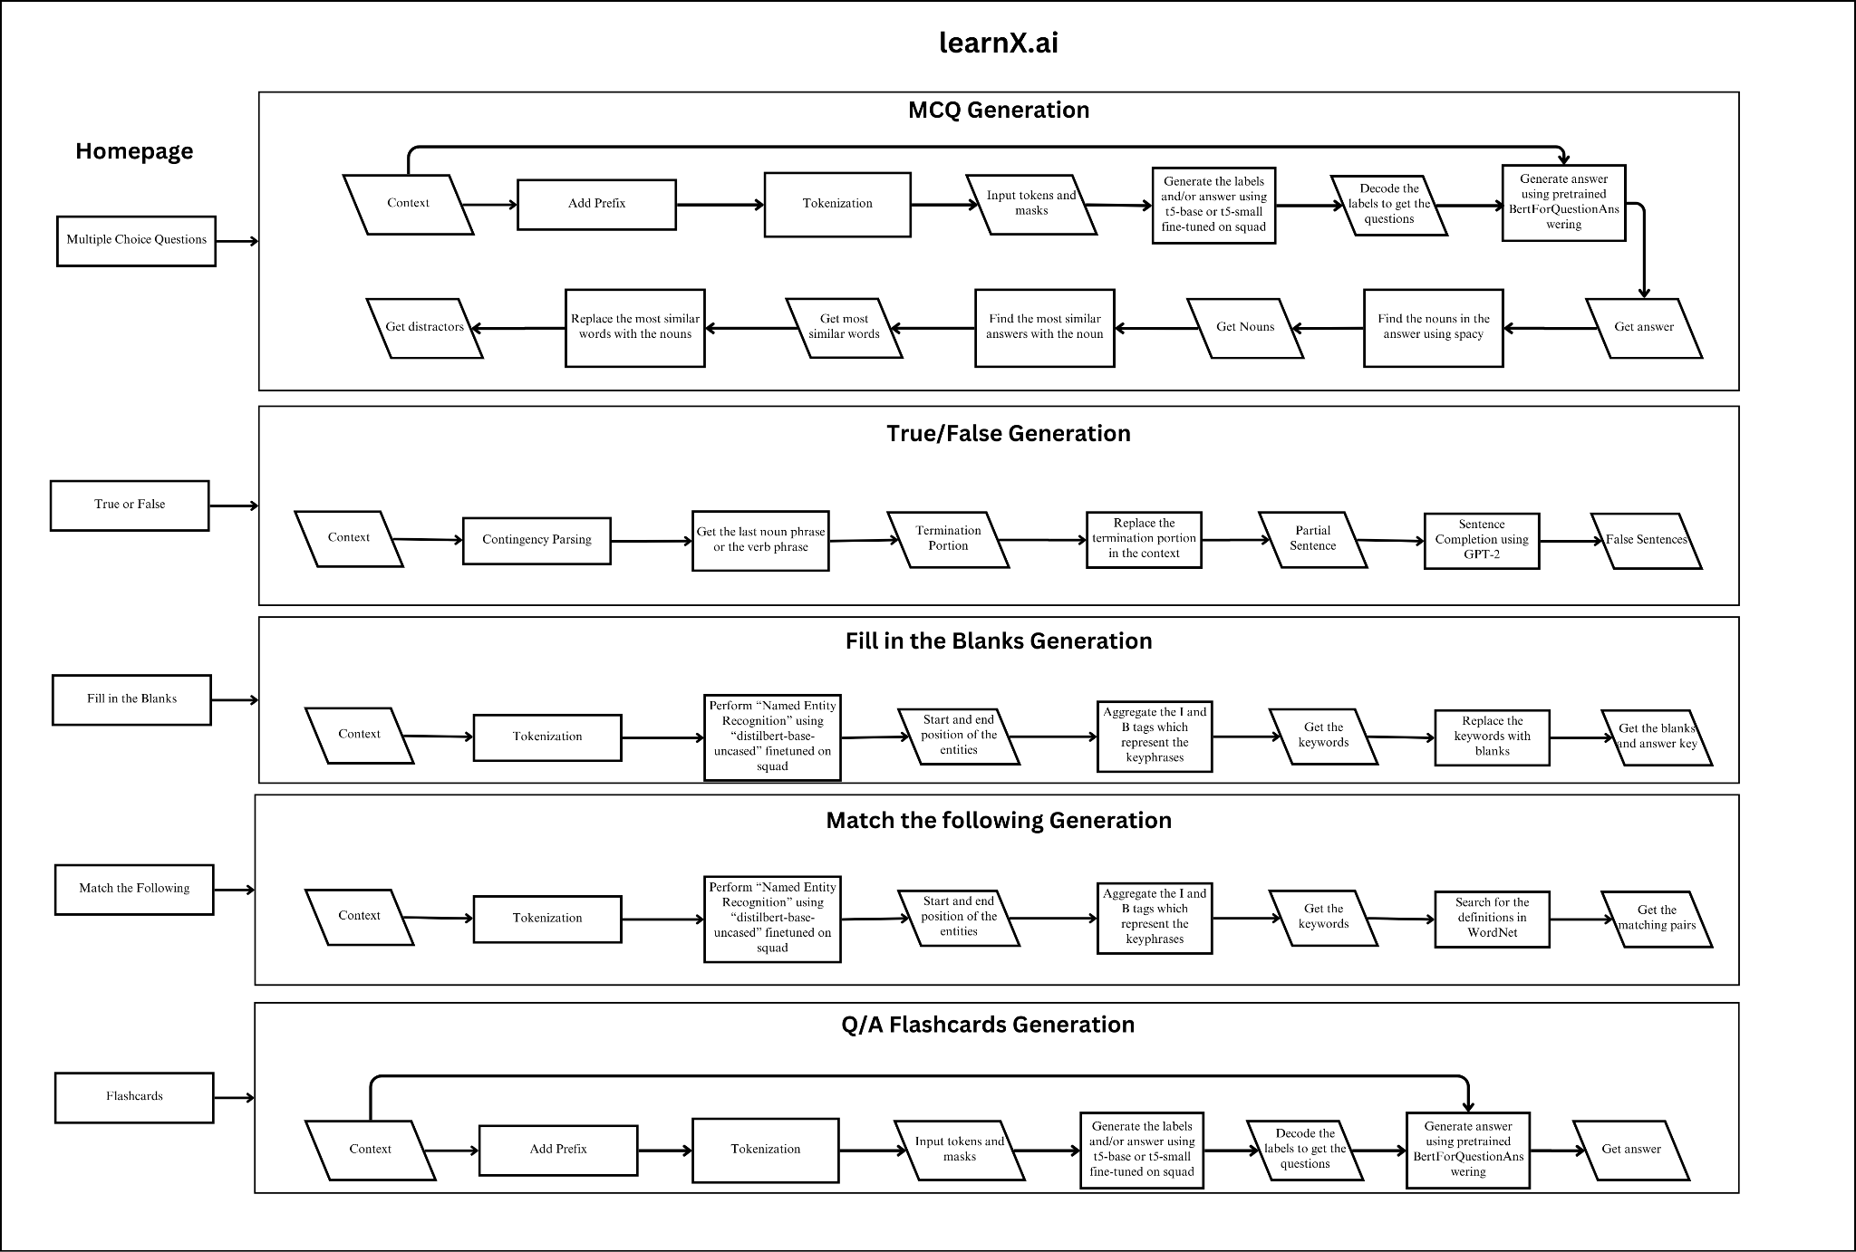

Slide 14
CORE AI COMPONENT ARCHITECTURE

Slide 15
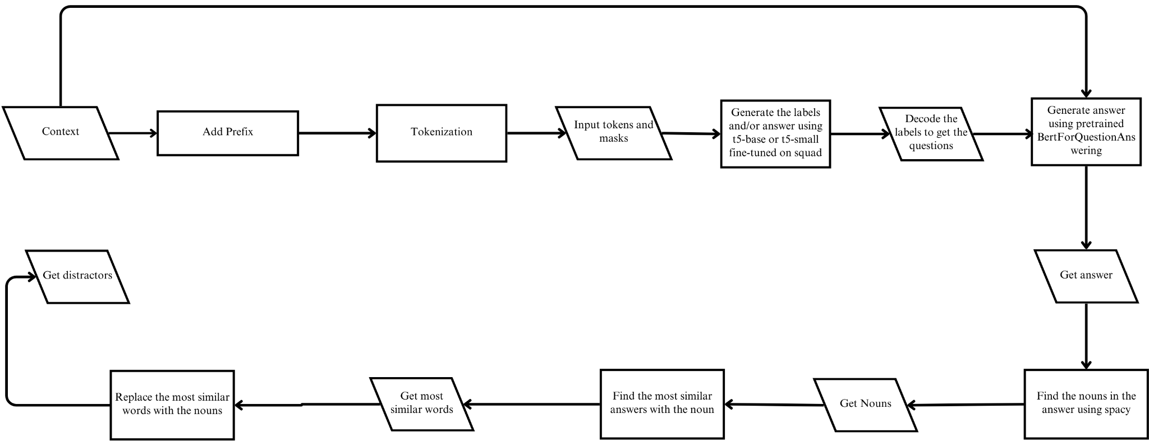
Block Diagram I

Slide 16
This component is used to generate MCQs. The input context is added with prefix and given to fine-tuned t5 model to generate the question and/or answer. The pretrained question answering model is used for extractive answer generation. Nouns are then extracted from the answer using spacy. The most similar words for these nouns are extracted using Sense2Vec. These words are replaced with the answers for generating distractors. Instead of using single model for doing question and distractors generation it will be efficient to use multiple components in terms of both time and accuracy.

Slide 17
Block Diagram II
This component serves the fill in the blanks question and answer generation. The input context is provided by the user which is processed by the system to perform identify the entities and their start and end position in the given context. The entities are aggregated to get the keyphrase and replaced with blanks in the context. Named entity recognition serves well with respect to other keyphrase extraction method because they are good in finding named entities such as proper nouns.

Slide 18
Other Components
Match the following uses the same AI component for keyphrase extraction. The only difference is that the match the following questions require definitions of the keyphrase.
True/False uses the GPT-2 architecture pretrained on language modeling task for sentence completion. The longest noun phrase of the sentence is replaced with the one that is generated using GPT-2.
Q/A flashcards uses the same AI component used for question generation.

Slide 19
TRAINING SETTINGS
batch_size = 4, num_epochs = 3, epsilon=1e-8, learning_rate=2e-5
optimizer = AdamW(model.parameters(), lr=learning_rate, eps=epsilon)
model = CustomModel(model_name_or_path, task_name)
logger = MLFlowLogger(experiment_name="learnX.ai (study support)", tracking_uri="http://127.0.0.1:8080")
checkpoint = ModelCheckpoint(dirpath="/content/drive/MyDrive/learnX.ai (study support)/checkpoints", filename="checkpoint-{epoch}-{step}", monitor="val_loss", mode="min", save_top_k=1, save_last=True, every_n_epochs=1)
trainer = pl.Trainer(max_epochs=num_epochs, accelerator="gpu", devices="auto", logger=logger, callbacks=[checkpoint])
trainer.fit(mode, train_dataloader, eval_dataloader)

Slide 20
Algorithm
for i=0 to max_epochs
model.train()
for train_batch in train_dataloader:
optimizer.zero_grad()
outputs = model(**batch)
loss = outputs[0]
log("train_loss", loss, on_step=False, on_epoch=True, prog_bar, logger=True)
loss.backward()
optimizer.step()
model.eval()
with torch.no_grad():
for eval_batch in eval_dataloader:
outputs = model(**batch)
loss = outputs[0]
log_dict(metrics, on_step=False, on_epoch=True, prog_bar=True, logger=True)
log("val_loss", val_loss, on_step=False, on_epoch=True, prog_bar=True, logger=True)

Slide 21
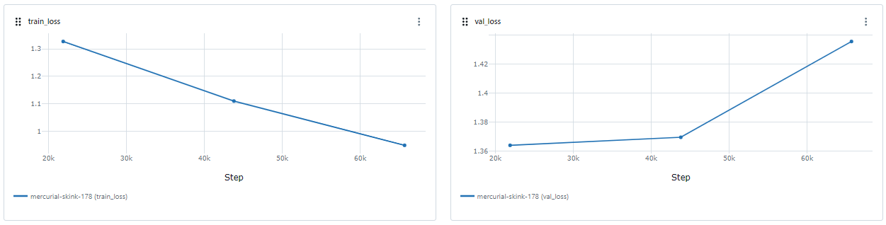
LEARNING CURVES
Loss curves for “t5-small”

Slide 22
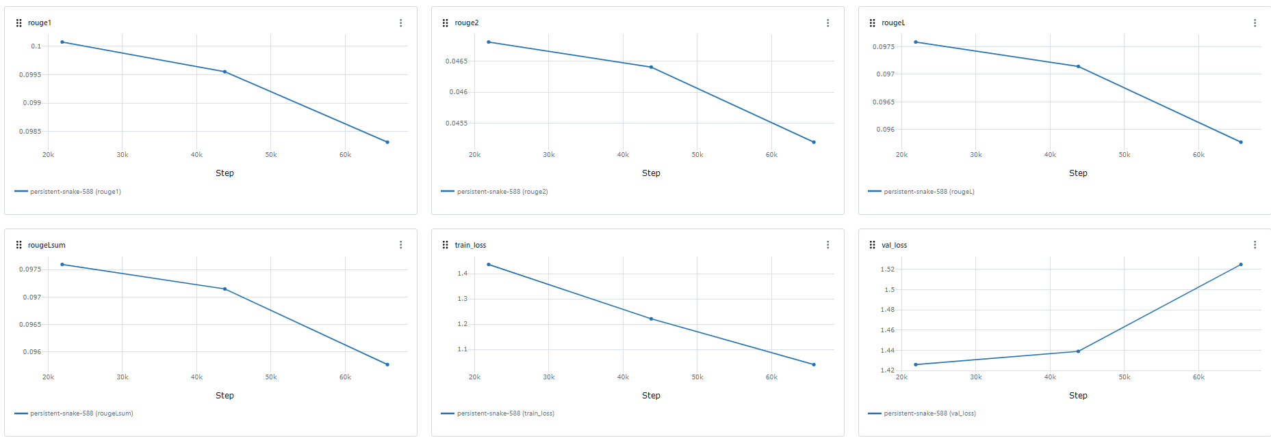
Learning curves for “t5-base”

Slide 23
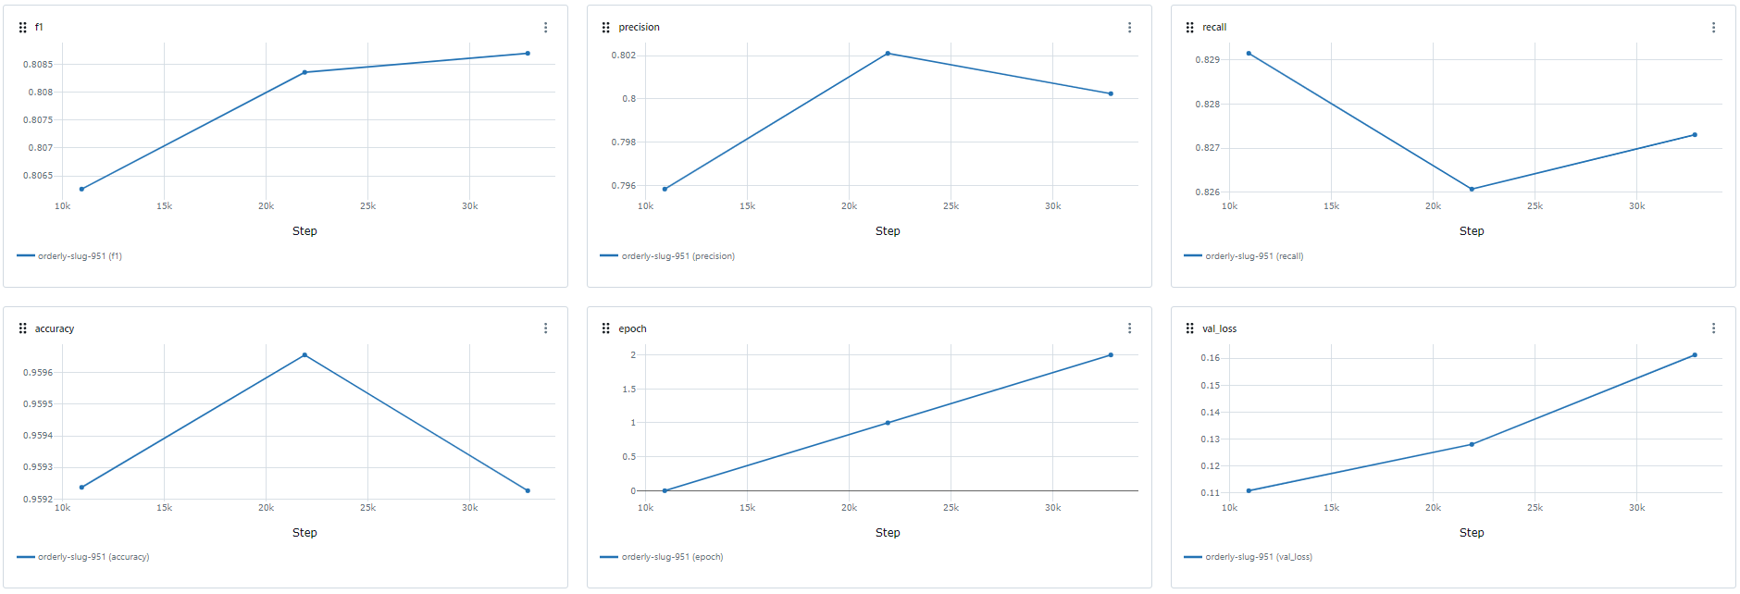
Learning curves for “distilbert-base-uncased”

Slide 24
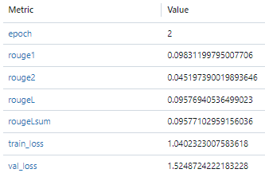
MODEL EVALUATION
Question Generation (rouge)

Slide 25
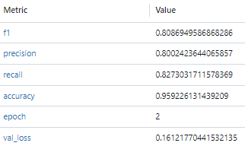
Token Classification (f1-score, precision, recall, accuracy)

Slide 26
SYSTEM PERFORMANCE ASSESSMENT
Measuring metrics in NLP is a task dependent system, so cannot use accuracy or any other metric for assessing all the components. Question generation uses rouge, Token Classification uses accuracy, precision, recall, f1-score, Language modeling uses accuracy scores for language modeling tasks.
Average time to generate questions = (29s + 3s + 2s + 15s + 15s)/5 = 12.8s
The latency of the system is 12.8 ⩰ 13 seconds.
The significant amount of latency is due to the distractor generation which tend to be very expensive.
The latency is measured in a system with AMD Ryzen 7 4800H processor and 8GB RAM.

Slide 27
SCOPES IN REAL WORLD
Instructors can assess their students understanding of a particular lesson by creating the questions based on the lesson.
Students can themselves learn different subjects through this platform by generating possible questions.

Slide 28
KEY FEATURES
Multiple Choice Questions
Fill in the Blanks
Match the following
True/False
Q/A Flashcards

Slide 29
SYSTEM FAILURE CASES
Questions where answers are made up of multiple words and whose part of speech is ambiguous, either distractors are not found or distractors are not appropriate.
Sometimes the answer generated by the pretrained transformer for question answering is not correct.
True/False Generator does not work as expected when given more than one sentences.

Slide 30
FUTURE ENHANCEMENT
To carry out few necessary enhancements in question generation process.
To create a production level environment where users can interact with the system.

Slide 31
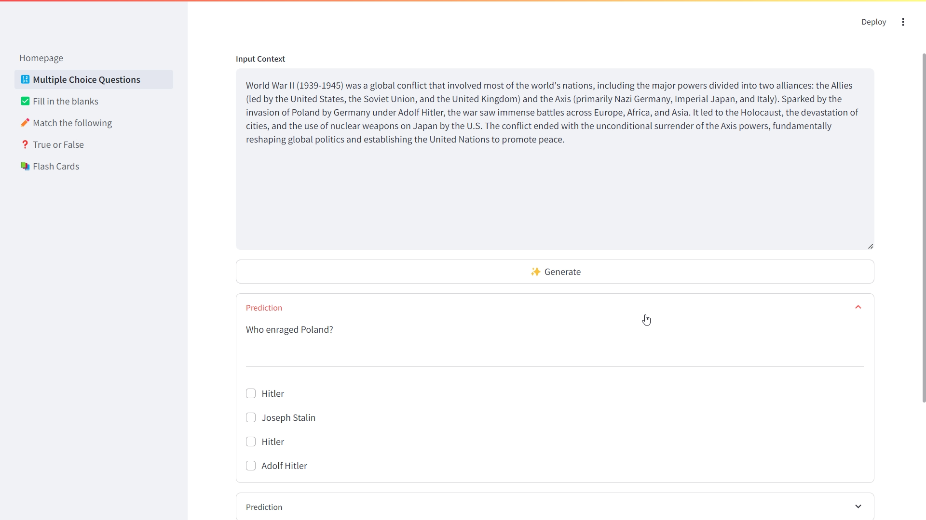
SCREENSHOTS

Slide 32
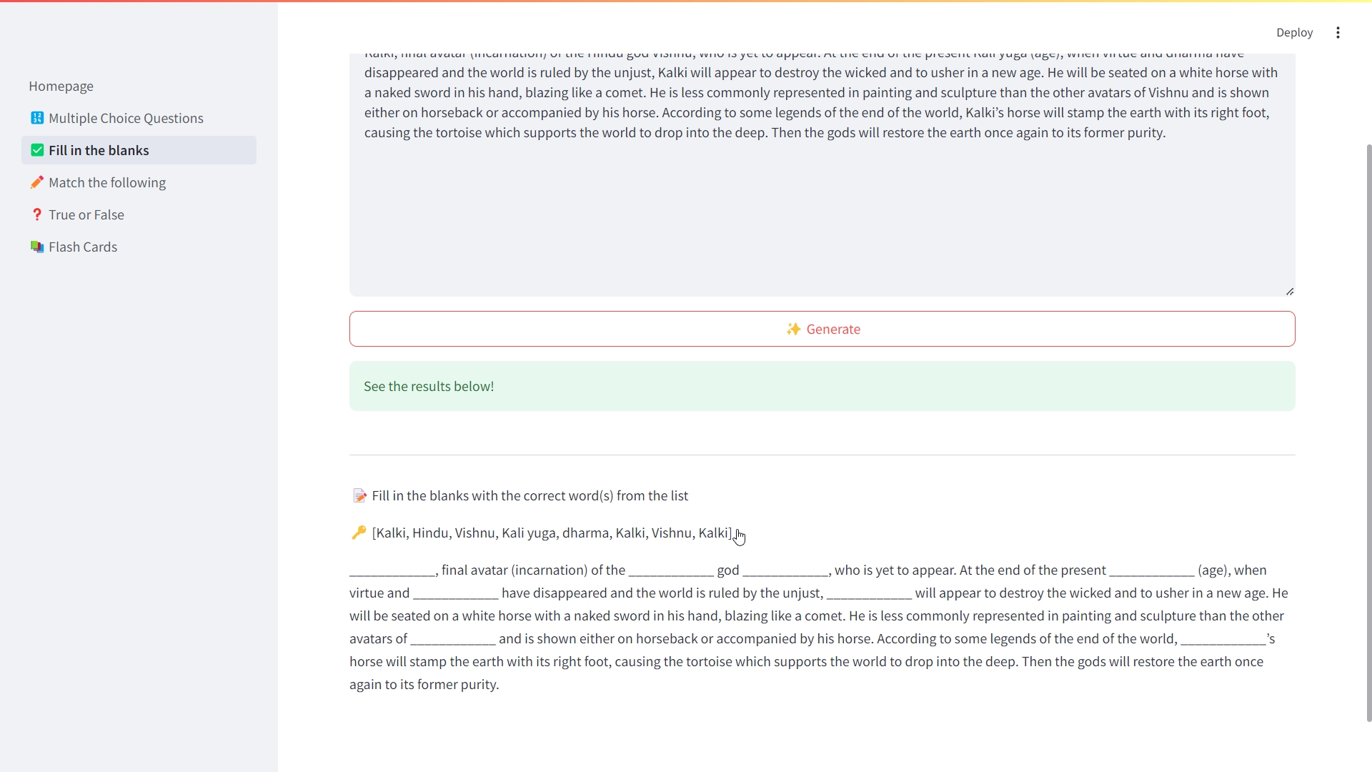

Slide 33
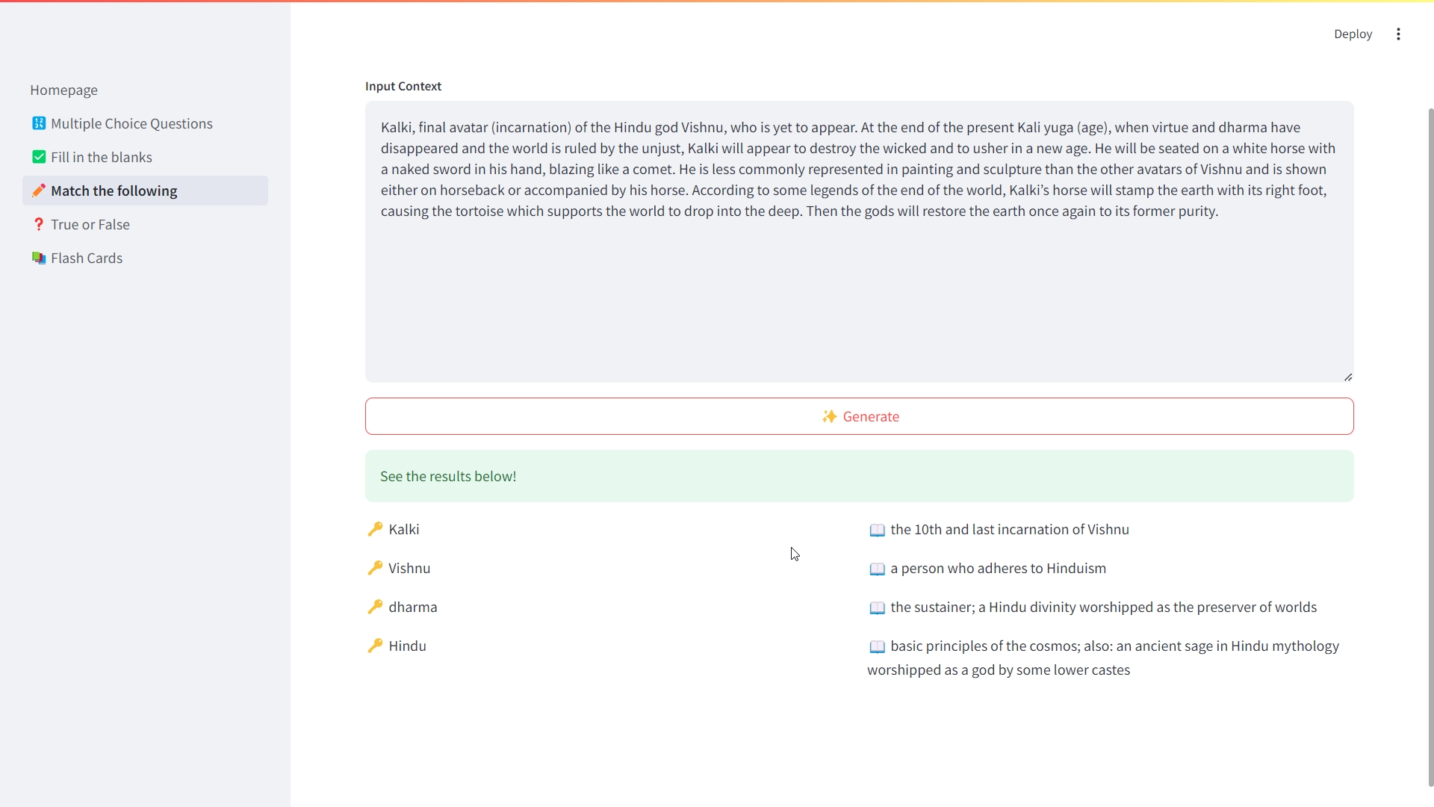

Slide 34
CONTRIBUTION AREAS
NAME | PROJECT CONTRIBUTION
Amir Bhattarai | Frontend, Backend, Prototyping, Training, Testing, Logging, Documentation etc.

